Slide 1
Endpoints Operations
Monthly Operations Summary
JL IT
June 2022

Slide 2
Executive Summary
Incident Management saw a slight increase in incident volume in June (2,972). The first call resolution, or FCR, was 84.83%. The overall SLA goal across all teams was met at 90.4%. Incident volume through the first two quarters of the year, when compared to last year, is down 16.4%.
Service Desk call volume dropped to 2,313 in June. Call volume through the first two quarters of the year, compared to last year, is down 20.7%. Calls answered within 30-, 60-, and 90-seconds goals were surpassed. Average speed to answer was 25 seconds. The abandonment rate goal for the month was also surpassed at 4.8%. Percentage of calls abandoned lowered by 23% in the first two quarters of the year. SLA goals were met by the Service Desk with an overall SLA score of 98.38%. We’re in the interviewing process for an analyst in the LA office.
Technology Operations assignment groups opened or received 395 incidents across the month. Critical alerts saw a significant increase due to ISP outages, temperature sensor alerts, and high CPU utilization. Modified the CPU utilization thresholds and polling rates to reduce CPU noise.
Endpoint Engineering found
Endpoint Projects continued in

Slide 3
Incident Management Summary
Service Desk Summary
Technology Operations Summary
Endpoint Engineering Summary

Slide 4
Incident Management

Slide 5
Incident Statistics
2,972 incidents were opened during the month, across all groups within SNOW. 26.25% of incident volume were emails. There was a phishing campaign this month that increased our email volume.
Phone: 2077
Email: 779
Self-Service: 80
Walk-in: 32
First contact resolution dropped slightly in June to 84.83% (as opposed to 85.35% in May).

Slide 6
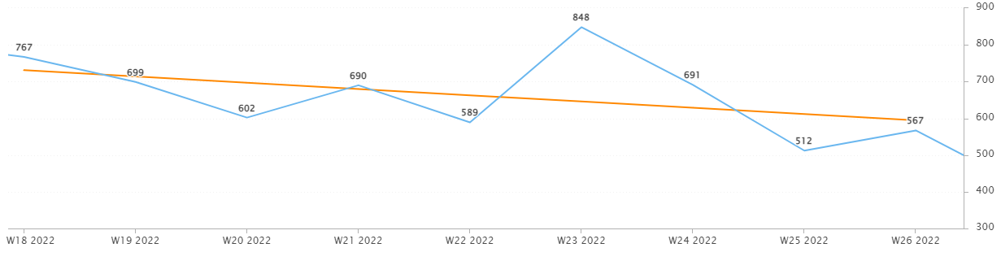
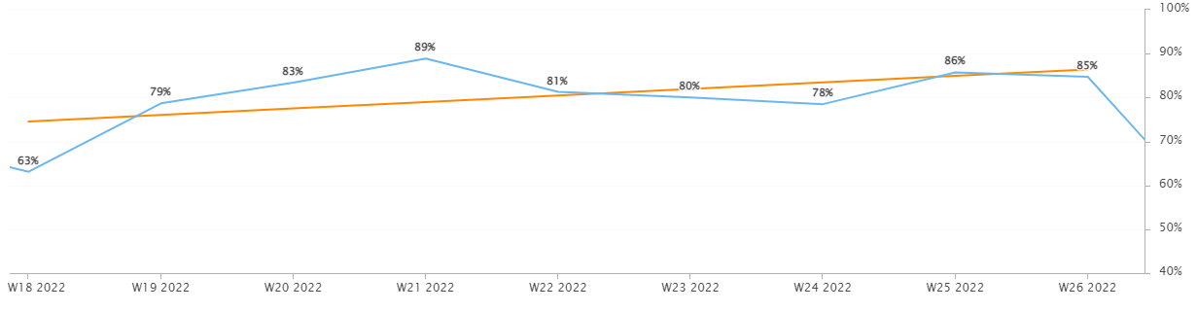
Incident Statistics
Incidents Opened by Week
Incidents opened by week continued to trended downward.
The percentage of incidents resolved the same day that they were opened trended upward in June.
Percentage of incidents resolved; same day opened.

Slide 7
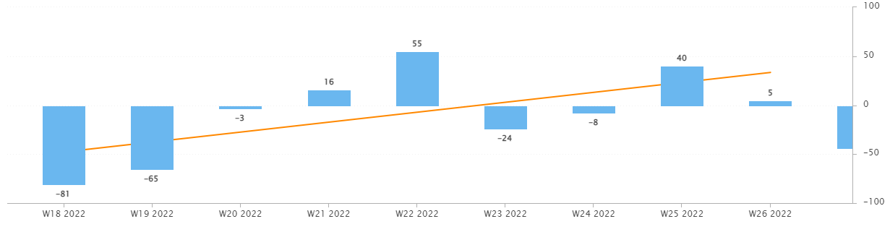
Incident Statistics
Open Incident Backlog Growth
Notes:
Backlog growth is a way of answering, “did we end the week with more or less incidents?”.

Slide 8
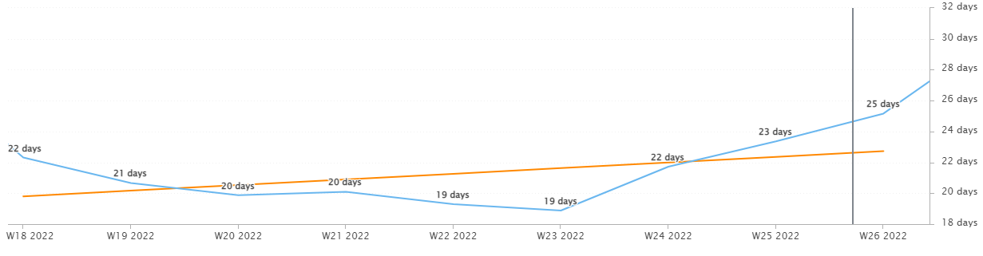
Incident Statistics
Average Age of Open Incidents
In June, the average age of open incidents trended downward.
Notes:
Please remind your teams to continue to work on their open incidents- this affects many of the previous slides as well as this one.

Slide 9
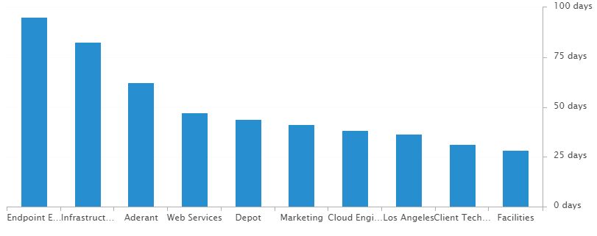
Incident Statistics
Average Age of Open Incidents by Assignment Group - as of the last day of the month

Slide 10
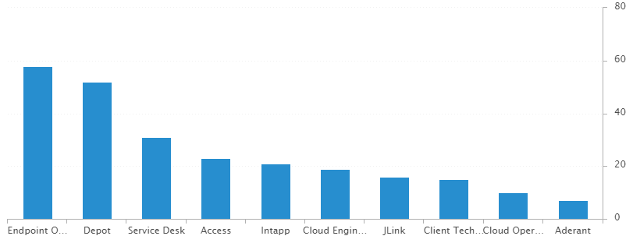
Incident Statistics
Open Incidents by Assignment Group - as of the last day of the month

Slide 11
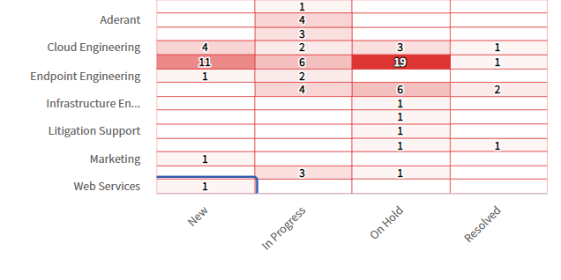
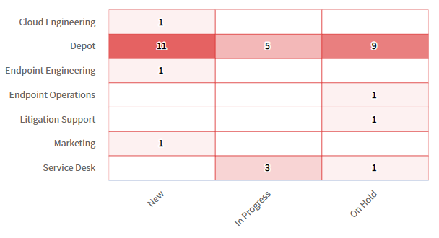
Incident Statistics
Open Incidents Older than 30 Days
Open Incidents not updated in last 30 days

Slide 12
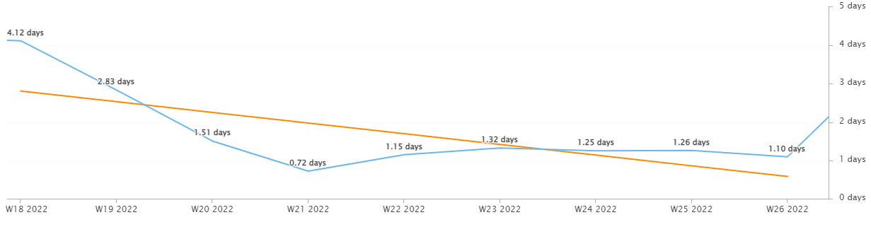
Incident Statistics
Average Resolution Time of All Resolved Incidents
The average resolution time trended down across the month (showing an improvement).

Slide 13
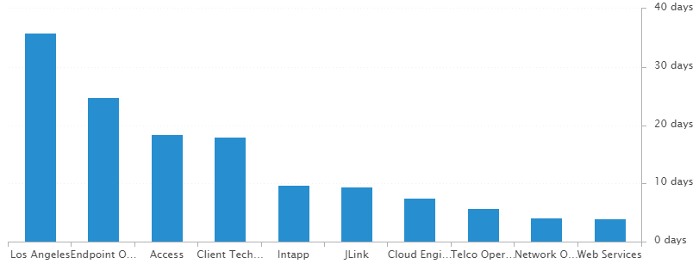
Incident Statistics
Average Resolution Time of Resolved Incidents, by Assignment Group

Slide 14
2022 SLA Goals & Actuals
Month | January | February | March | April | May | June | July | Aug | Sept | Oct | Nov | Dec
Goal | 90% | 90% | 90% | 90% | 90% | 90% | 90% | 90% | 90% | 90% | 90% | 90%
Actual | 88.8% | 88.1% | 92.7% | 92% | 90.6% | 93.9%
The Incident SLA goal in June was met across all teams.

Slide 15
Problem Statistics
There are currently 12 open Problems across teams.
1 is critical priority
1 is high priority.
10 are moderate priority or lower.

Slide 16
Service Desk

Slide 17
Year over Year Quarterly Results
Total incident, abandons, and call volume reduced in Q2 2022 over 2020 and 2021.

Slide 18
Key Call Statistics
Call volume dropped in June to 2,313 calls.
The abandonment rate monthly goal is 9%.
The goal was met, ending the month with 4.80%.
Notes:
~
There are several stats tracked for individual analysts as well as for the team and the org. Across the next few slides I’ll highlight some key statistics for the Service Desk team.

Slide 19
Key Call Statistics
The Service Desk met all 3 goals for each range. This correlates with the call volume and abandonment rates.
The goals for each time period:
70% of calls handled within 30 seconds.
75% of calls handled within 60 seconds.
80% of calls handled within 90 seconds.
Notes:
Over 75% of calls were handled within 30 seconds.
Over 80% were handled within 60 seconds.
Over 83% were handled within 90 seconds.
~
We track multiple metrics for calls handled- or how quickly a call is answered- within specific time periods. I’ve highlighted three here, calls handled within 30, 60, and 90 seconds.
The takeaway from these numbers should be that we are answering calls quickly which prevents calls from abandoning. Typically, we see the abandoned calls rise when these goals are not met- specifically the 60 seconds metric.

Slide 20
Key Call Statistics
The average speed to answer was 25 seconds which correlates with the trend of call volume & abandoned calls alongside the higher percentages for the calls handled within 30, 60, and 90 seconds.
Notes:
~
Average speed to answer is the average of how quickly all calls were answered by the Service Desk for the month.

Slide 21
Incident Statistics
Closed Monthly Data:
Incidents closed by SD: 2,375
Total Closed Incidents: 2,884
Closed by SD Percentage: 82.35%
Incidents closed by Service Desk, by Source:
Phone: 1742
Email: 563
Self-Service: 37
Walk-in: 31
Notes:
~
The typical methods for contacting the Service Desk are phone and email, which explains the results in the incident source chart.
Self-Service we hope to expand over the next year and drive users towards generating their own incidents and using the JL Service Center more actively.
Walk-ins are low month-to-month with the split schedule for Return to Better. But from analyst feedback incidents for walk-ins are not being opened consistently. I aim to correct this over the rest of this year. I’ve also added it as a 2022 goal for each analyst within their reviews.

Slide 22
Incident Statistics
Top 5 Subcategories:
Microsoft Office (482)
NetDocuments (329)
Report Phish (190)
Power PDF (141)
Windows (115)
Top 5 Customers:
Suddie Scott (27)
Barbara Bona (17)
Ann Rake (16)
Gwen West (15)
Joanne Boyd (15)
Average Incident/employee/month: 1.61
Average Incident/new hire/month: 2.28
Notes:
Across the month _had the highest number of related incidents.
Top 5 customers in the month are listed here.
Looking at the chart, we’re tracking incident volume per new-hire per month and comparing this to last year.

Slide 23
2021 Service Desk SLA Statistics
Survey Response Comment Highlights:
5/5: “Stéphane did a fantastic job and was very helpful. “
5/5: Taylor – “quickly and efficiently handled the issue i was having with my computer. A pleasure to work with.”
5/5: “Blaise didn't even make too much fun of me for my lame question. Thank you!”
5/5: “A+ support for an overwhelmed new hire. Gold stars for everyone. I appreciate you.”
5/5: Chris – “The help desk analysts are always very helpful and can usually fix the issue I'm having when I call the Help Desk. Keep it up!”
September | Breached | Has not Breached | SLA %
Response | 55 | 2322 | 97.63%
Resolution | 21 | 2356 | 99.11%
Overall | 76 | 4678 | 98.38%
Response & Resolution SLA timers are determined by the Priority of the Incident.
Both Response and Resolution SLA reviewed on this slide are across all Priorities.
Notes:
Service level agreements/SLA
Response & Resolution SLA timers are determined by the Priority of the Incident.
Both Response and Resolution SLA reviewed on this slide are across all Priorities.
~ The Service Desk team is uniquely prepared to meet SLA goals. We generate incidents during calls, while emails generate their own incidents.

Slide 24
Knowledge Statistics
Top viewed articles, Self Service:
How do I contact the Service Desk?
How to install a network printer
How to manage call forwarding remotely
How to use Biscom
Top viewed articles, IT:
Escalation paths and category guide
Intapp Time Troubleshooting
JL Storage & Network Drives
TeamViewer: Remote control
Average Article rating: 4.64/5
Did you know?
2,181 searches were made from within the JL Service Center by 194 unique users.
These searches were across both Knowledge & Service Center.
The most common search related to data missing or misplaced in JLink.
Notes:
Knowledge within Service Now, is maintained by a few of us in the Service Desk team.
We evaluate resolved Incidents that have been flagged for knowledge.
On most of these flagged Incidents the fix or solution are not detailed by the escalated teams.
Knowledge is split into 2 sections. IT visible and Self-Service.
Please push your teams to write out the steps taken to resolve an issue, whenever possible.
This helps with knowledge but also helps when a user has a repeat issue, or the issue occurs for another user.
Reminder: your teams can generate their own knowledge articles. These will be used to increase our first call resolution and avoid escalating incidents.

Slide 25
Update & Reminder Highlights
Mimecast: Remember that the process for releasing suspicious URL or badly structured messages is in knowledge. Please review it.
Passwords: A reminder that we should be following this article’s steps when resetting an account password.
The general password policy has been updated with some slight changes as well.
Phishing Campaign: The next phishing campaign from Security will take place on June 6th. See the table below for details.
As users report these as Phishing, you may resolve the incident using the Spam/ReportPhishing template.
Please do not tell users this campaign is occurring.
Keep in mind these emails will be coming from multiple varied email addresses.
Please do not block any of these or escalate these to other groups.
Litera Training: Training sessions at 2 pm on both the 16th and 23rd to split us up for coverage. We will support three offerings from Litera when this goes live later this year. Please attend your assigned session.
CHG0032427: After this Change is completed today, users will need to be enrolled with Duo prior to enrolling their device with Intune.
Relocation: Chris is relocating to our Boston office beginning July 11th.
OA Change: Jessica Dalziel is now the OA for Orlando, Raleigh, and Charlotte.
Notes:
Some highlights from the month’s U&R emails are listed here.
One to two emails are sent a week to the Service Desk reminding them, or updating them on, changes to existing workflows or policies. Quick notes sent via Teams are also rolled up into these emails to be sure that these points are not missed. All U&R emails are listed in Confluence for reference by other teams.

Slide 26
Technology Operations

Slide 27
Escalation Status

Slide 28
Escalation Baselines

Slide 29
Escalation Statistics
In June, ISP and temperature sensor alerts and CPU utilizations drove up alert totals.

Slide 30
Websites Uptime - June
Website​ | Uptime - June​
Aderant​ | 100%​
Intapp Walls​ | 100%​
JL - Home​ | 99.593%​
J Link​ | 99.996%​
NBI ​ | 99.525%​
Payments Credit Card​ | 99.957%​
Dashboard​ | 100%​
Biscom​ | 99.995%​
Citrix​ | 100%​
VPN East​ | 99.997%​
VPN West​ | 99.72%​

Slide 31
Endpoint Engineering

Slide 32
Endpoint Analytics
•Overall score continues its climb(+1) reflecting successful deployments of base apps, older hardware retiring and quicker turn around for updating existing software.
•App Reliability increased +3 primarily due to our Vulnerability projects to remediate aging and less secure versions of software as well as particular security settings that our Security provided us.

Slide 33
Endpoint Model Inventory
•Continuing to replace older hardware as our Microsoft fleet expands firmwide, improving stability and performance.
•Our worst performing model in the past. Surface Pro(5) has officially been retired from the environment! Also looking forward to our Surface Pro 8’s arrival and we anticipate a continued upward trend in performance and stability.

Slide 34
Endpoint Model Performance
The retirement of our Surface Pro(5) model will provide improvements to all scores.
Our oldest hardware, HP Mini G4,still holds our best boot score, while Surface Laptop 3 and 4 hold the best avg. for both boot and sign-on times.
Our worst sign-on score, 830 G5’s should be retired from the environment by years end.

Slide 35
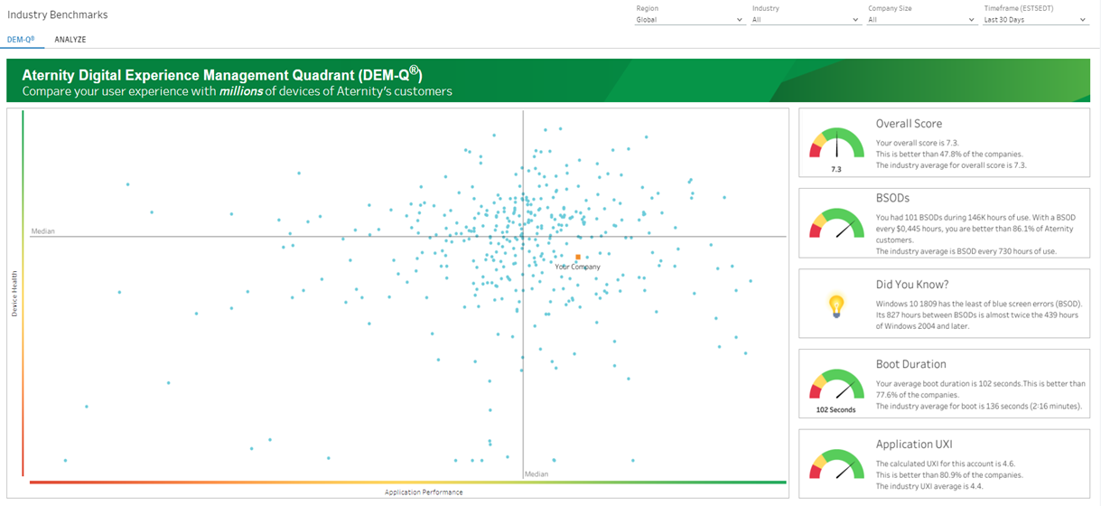
Aternity DEM-Q Performance
DEM-Q rose a bit to 8.0 for June 2022. (Ind avg – 7.3)
BSOD held the same for June 2022 at 107 every 153k hours of use. (Ind avg - 1 BSOD every 730hrs)
Boot duration improved to 101secs, down 2secs from May 2022. (Ind avg – 136secs).

